Slide 1
NBA Stat Visualizer Project
by Lorenzo Rawls
5/11/2025
COMPSCI-2

Slide 2
Introduction
Currently I am a freshman at Chaffey College and I am pursuing my associates degree in Computer Science. This is my second CompSci course at Chaffey and so far it has been a pretty solid experience.
My motivation behind this project stemmed from my passion for basketball (the playoffs have been exciting this year) and my desire to apply C++ concepts to a real-world data visualization task. I have always been a big fan of basketball and kind of a “stats-nerd” so this really fed into and blended both my passion for the game and for coding.

Slide 3
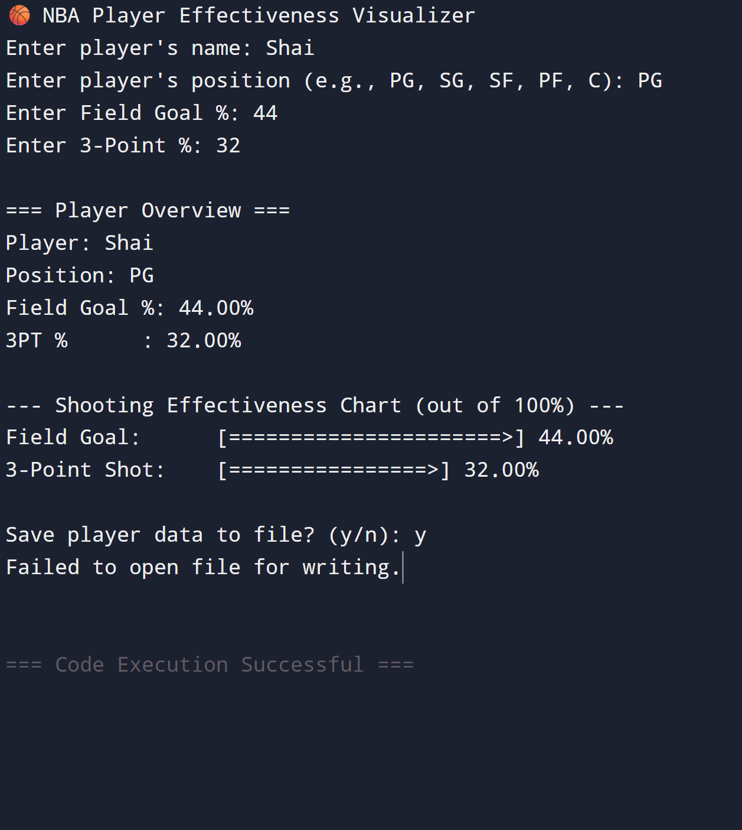
Implementation
nba-stat-visualizer.cpp
My project was implemented in C++ with a strong focus on clean, modular code design. At the core is a Player class that takes in all relevant player data, such as name, position, field goal %, and three-point %, and along with member functions for displaying formatted statistics, renders ASCII-based charts, and converts data for file output to the nba_players.txt file. The program uses a mix of cin and getline commands for user input and requires a careful handling of newline characters using cin.ignore() to prevent input skipping. Input validation is handled through a dedicated function that ensures percentage values remain within the 0–100 range, using loops and cin.fail() to catch invalid entries. The ASCII visual representation of the inputted stats is achieved by turning the percentages into character bar lengths using string(fgPercentage / 2, '='), which creates a proportional bar. For file output, the program uses ofstream in append mode to write player data as comma-separated values, preserving prior entries without overwriting. Overall, the implementation was simple in construction but required very specific formatting and code such as #include <fstream> for the file input and output.
(It says failed to open file for writing because this was taken from an online compiler)
Year

Slide 4
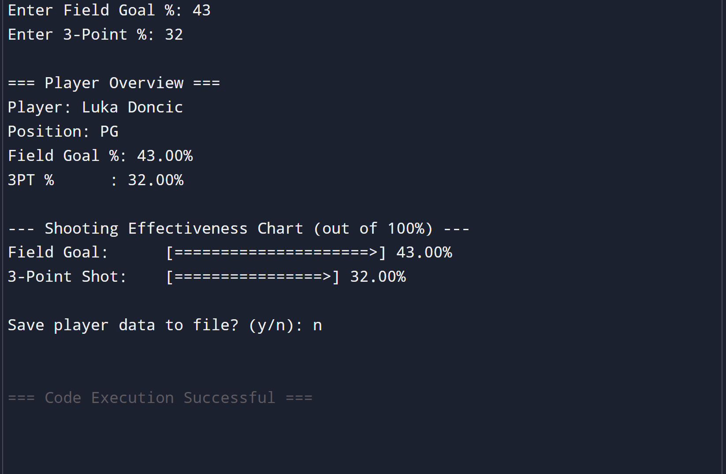
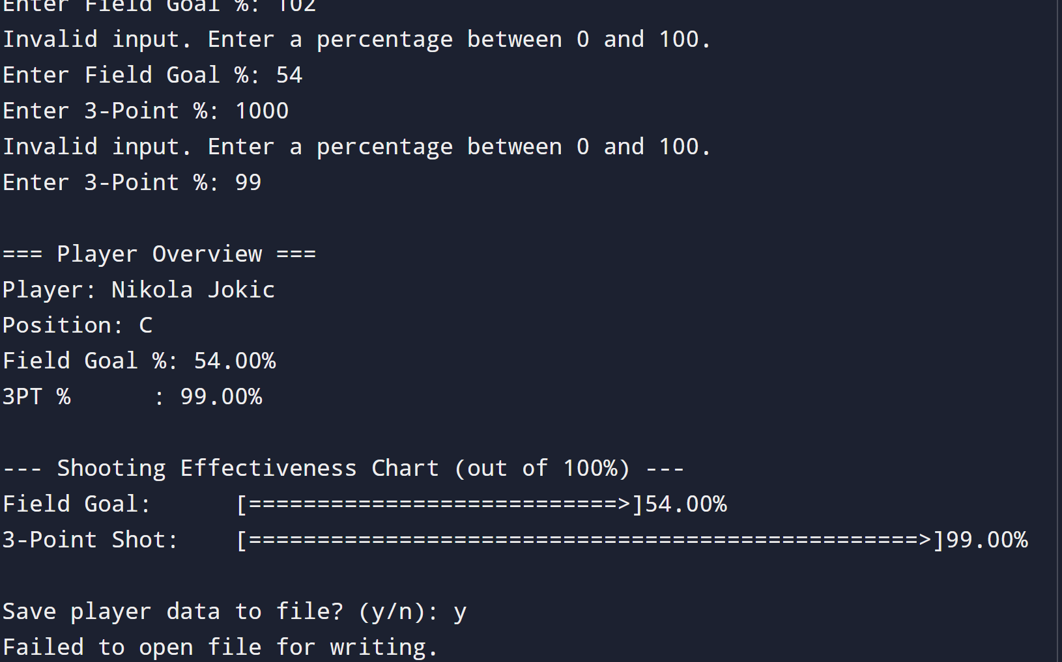
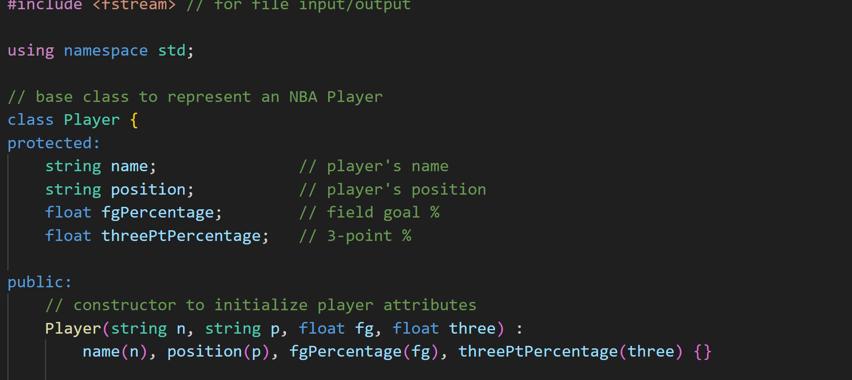
Project Demo
On the right you can see screenshots of the code in action, the output displays different nuances that you can get based on if you input valid stats or not.
Over there
Screenshots taken on programiz.com and VSCode.

Slide 5
Future Work,
Hopeful Improvements, and Conclusive Thoughts
Hopefully by uploading this to GitHub and continuing to work on it I’ll be able to use it to help with future internships or employment.
In the future I hope to implement an NBA stats API into this code, removing the need for inputting player stats manually and I also hope to use other means to better visually display the data.
Overall, this project was enjoyable and rewarding and really allowed me to apply the C++ concepts we learned this semester in a practical way. I really like this project and value it over my last one because it feels more personally inspired and I think it is a good showcase of where I am as a freshman level coder.
By Lorenzo Rawls
🔗https://github.com/schizoschizo/nba-stat-visualizer

